Slide 1


Green Pace
Security Policy Presentation
Developer: Daniel Olaosebikan
Cs 405
Southern New Hampshire

Slide 2

OVERVIEW: DEFENSE IN DEPTH
Defense in depth is the approach to information security where security mechanisms are carefully and thoughtfully layered, in order to create a stronger protection against risk and possible vulnerabilities in a system.

Slide 3
THREATS MATRIX
Likely STD-003-CPP STD-004-CPP STD-005-CPP STD-009-CPP STD-010-CPP | Priority STD-003-CPP- P18 STD-004-CPP- P18 STD-005-CPP- P18 STD-009-CPP- P9 STD-010-CPP- P18
Low priority STD-002-CPP- P4 STD-006-CPP- P1 STD-007-CPP- P1 STD-008-CPP- P2 | Unlikely STD-001-CPP STD-002-CPP STD-006-CPP STD-007-CPP STD-008-CPP
The highest priority threats should be prioritized more while the low priorities should also be implemented but shouldn’t be prioritized higher than the higher priority threats.

Slide 4
10 PRINCIPLES
Validate Input Data
Heed Compiler warning
Architect and Design for security policies
Keep it Simple
Default Deny
Adhere to the principle of least privilege
Sanitize Data sent to Other systems
Practice Defense in Depth
Use Effective Quality Assurance Techniques
Adopt a Secure coding Standards

Slide 5
CODING STANDARDS
Do not declare or define a reserved identifier.
Do not cast or delete pointers to incomplete classes
Do not attempt to create a std::string from a null pointer
Prevent SQL Injection
Do not access freed memory
Understand the termination behavior of assert() and abort()
Do not return from a computational exception signal handler
Do not access a variable through a pointer of an incompatible type
Ensure that operations on signed integers do not result in overflow
Exclude user input from format strings

Slide 6
ENCRYPTION POLICIES
Encryption at rest: Encryption at rest is encryption that is used to help protect data that is stored on a disk (including solid-state drives) or backup media
Encryption in flight: Encryption in flight protects contents in transit. Encryption at rest maintains protection at the remote destination until the recipient applies the proper passphrase.
Encryption in use enables computations on ciphertext in a way that, once you decrypt data, the output is the same as if the computer operated with plaintext files.

Slide 7
TRIPLE-A POLICIES
Authentication: Authentication is the act of confirming the truth of an attribute of a single piece of data claimed true by an entity. In contrast with identification, which refers to the act of stating or otherwise indicating a claim purportedly attesting to a person or thing’s identity
Authorization: Authorization is the function of specifying access rights/privileges to resources related to information security and computer security in general and to access control in particular
Accounting: This is the process that keeps track of a user’s activity while attached to a system; the trail included the amount of time attached, the resources accessed, and how much data transferred. Accounting data is used for trending, detecting breaches, and forensic investigating.

Slide 8
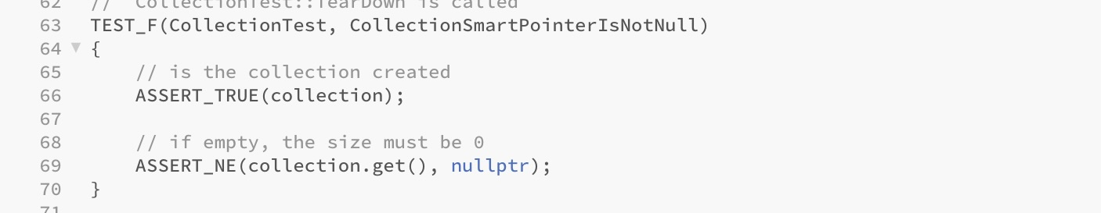
Unit Testing
COLLECTIONSMARTPOINTERISNOTNULL

Slide 9
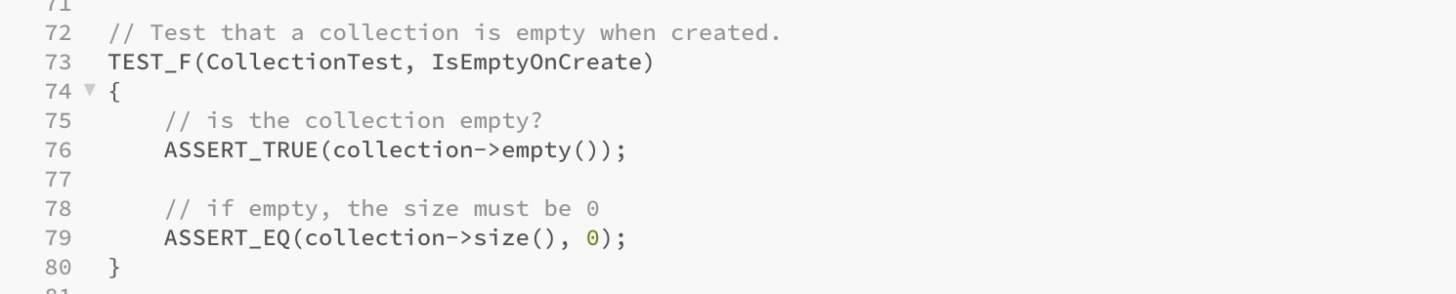
Unit Testing
ISEMPTYONCREATE

Slide 10
Unit Testing
ALWAYSFAIL

Slide 11
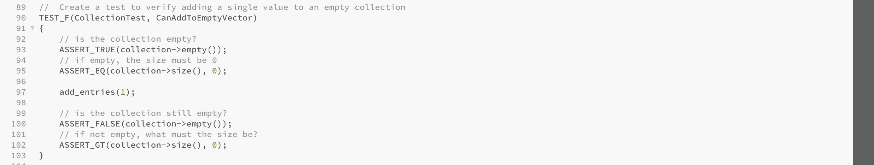
Unit Testing
CANADDTOEMPTYVECTOR

Slide 12
Unit Testing
CANADDFIVEVALUESTOVECTOR

Slide 13

AUTOMATION SUMMARY

Slide 14
TOOLS
DevSecOps pipeline is the integration of security practices tooling scanning, threat intelligence and more to software development cycle.
Tools:
Parasoft C/C++test: This is an integrated development testing solutions that help developers improve software qualities.
Astrée: this is a static analyzer that analyzes programs written in C++.
Polyspace Bug Finder: Checks for cast to pointer pointing to object of different type (rule partially covered)

Slide 15
RISKS AND BENEFITS
[Describe the problems, the solutions, and the risks or benefits involved if you act now or wait. Where is the strategy lacking? What are the risks of using this strategy? Which steps should be taken?]
Risks:
It could risk losing customers because their data will be leaked and they wouldn’t want to work whichever company again.
It could risk having huge financial problems
Vulnerable to multiple attacks
It could cause harm to data
Solutions to avoid this risks:
Implement security early
Reduce the possibility of overhead
Always do a through check to make sure there is no vulnerability and every security put in place works.

Slide 16
RECOMMENDATIONS
Possible Gaps in Security Policy:
Having a white hat security firm or hacker to check software can give real life tests and see if there is vulnerabilities that need to be fixed.
Implementing this polices early will help with making sure that there is security in place to avoid any future problems.
Make sure tools that are being used are very efficient and suit whatever software it is being used for

Slide 17
CONCLUSIONS
Handle all exceptions
Validate Input data
Default Deny
Sanitize Data
Follow and review defense in depth strategies and understand the security policy

Slide 18
REFERENCES
Google. (n.d.). Default encryption at rest | documentation | google cloud. Google. https://cloud.google.com/docs/security/encryption/default-encryption
Content encryption: In Flight and at rest. (n.d.). https://www.ibm.com/docs/en/aspera-on-cloud?topic=encryption-content-in-flight-rest
Velimirovic, A. (2023, November 16). Data Encryption in use explained. phoenixNAP Blog. https://phoenixnap.com/blog/encryption-in-use#:~:text=Encryption%20in%20use%20enables%20computations,data%20into%20memory%20for%20processing.
Authentication, authorization, accounting and Identity Management. CCSI, A Sourcepass Company. (2019, April 29). https://www.ccsinet.com/blog/aaa-identity-management/
Michali. (2022, September 15). What is a DevSecOps pipeline?. Check Point Software. https://www.checkpoint.com/cyber-hub/cloud-security/devsecops/what-is-a-devsecops-pipeline/

